Slide 1


SMART INDIA HACKATHON 2025
TITLE PAGE
Problem Statement ID – SIH 25031
Problem Statement Title-
Crowdsourced Civic lssue Reporting and Resolution System
Theme- Clean & Green technology
PS Category- Software
Team ID-
Team Name – Civic Wave

Slide 2
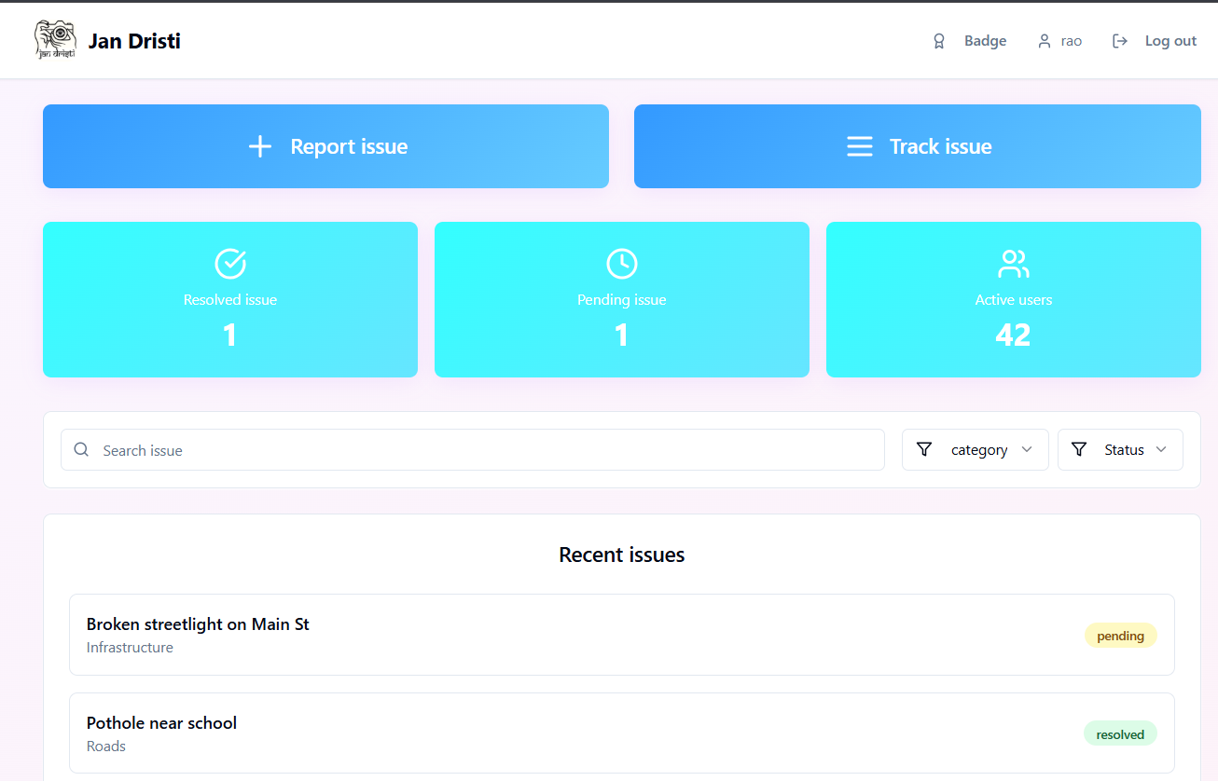
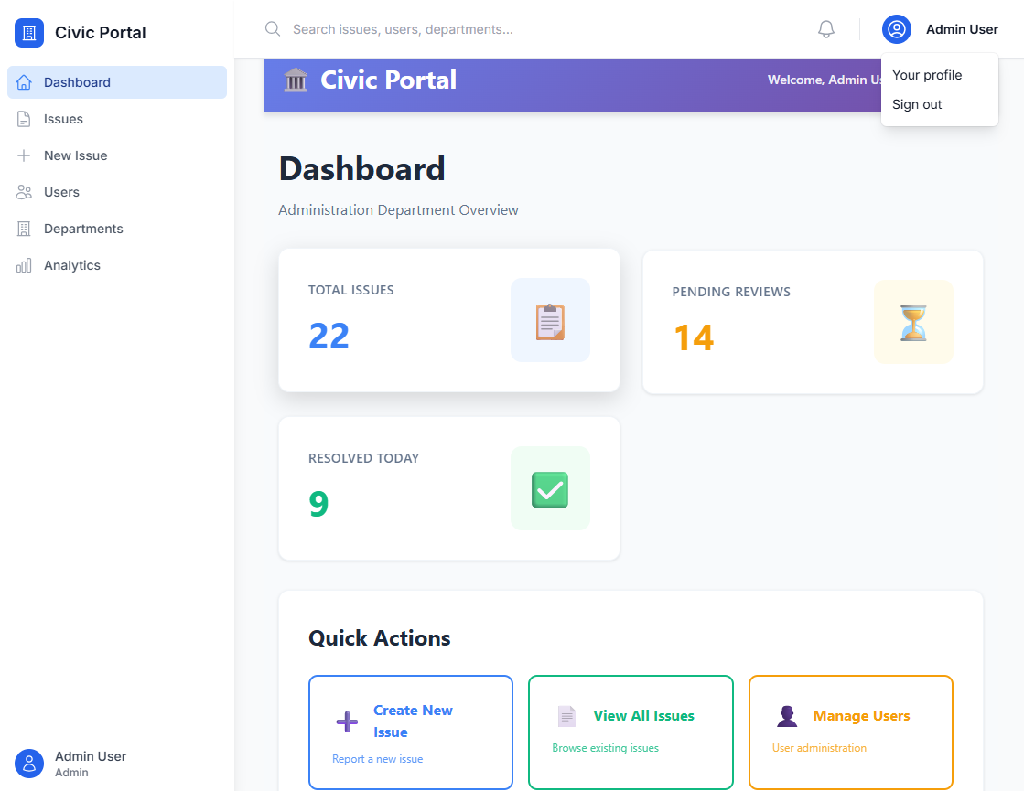
JAN DRISTI
Civic
Wave
Citizen portal
Proposed Solution:
Easy Reporting: Citizens can quickly report civic issues with photos and location details.
Live Tracking: Users can track the progress of their complaints in real time.
Regular Updates: Notifications keep people informed about issue status.
Gamification: Badges and rewards motivate citizens to take part actively.
User-Friendly Platform: Simple and accessible design for everyone.
Problem Addressed:
Lack of easy, real-time reporting for civic issues.
Delays and negligence in addressing complaints.
Low citizen engagement due to lack of updates and trust.
Uniqueness and Innovation of solution:
The platform provides real-time updates on issue status, enabling transparent tracking for both citizens and authorities.
It offers badges and progress tracking to motivate and engage citizens regularly.
Real time status updates and monitoring.
Promotes engagement by simplifying issue reporting with images,various categories and authentication features.
Government portal

Slide 3
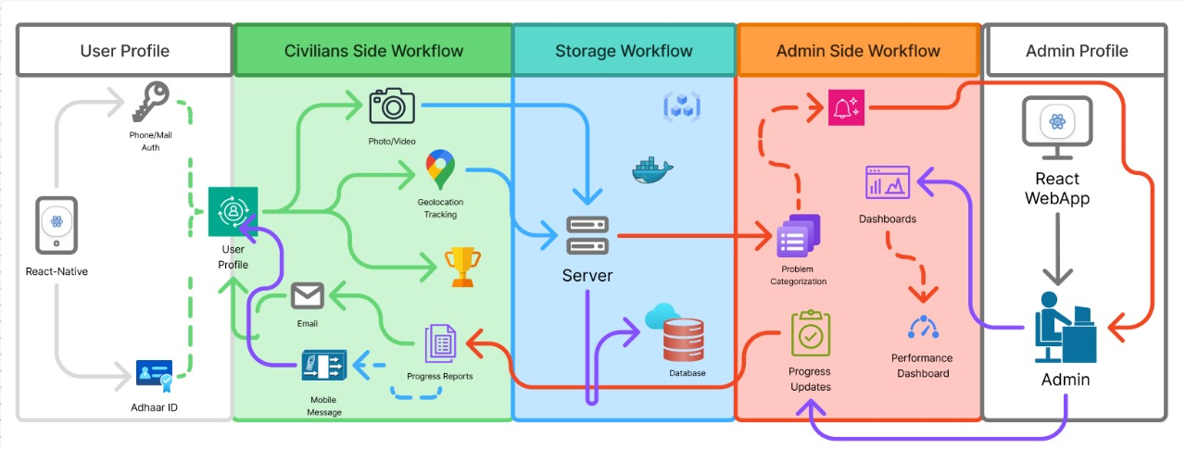
TECHNICAL APPROACH
Civic
Wave
Data Storage
PostgreSQL
Sequelize ORM
Multer
Backend
Node.js
Express.js
Socket.io
Frontend Interface
Tailwind CSS
React 18
Leaflet
React Query,React router
Infrastructure & Services
AWS S3
Docker
Twilio
Rechart
Database and Security
Helmet.js
CORS

Slide 4
FEASIBILITY AND VIABILITY
Civic
Wave
Feasibility Analysis
Support Technologies like React,TypeScript.
User friendly Design.
Potential Challenges and Risk
Delay or lack of action from authorities may reduce trust.
Sensitive user data might be at risk.
Strategies to overcome Challenges
Provide admin dashboard for efficient issue management.
Secure authentication and clear privacy policy to build trust.
Increase citizen Engagement and trust in governance.
Scalability Plans ensure long term growth.
Risk of false reporting or spam or misuse of platform.
Implement verification and reporting mechanism to maintain integrity.
Data Management

Slide 5
IMPACT AND BENEFITS
Civic
Wave
IMPACT:
BENEFITS:
Faster Issue Identification: Allows for proactive municipal response and reducing unaddressed issues in the city.
Reduced Corruption and Negligence: Automated tracking greatly reduce the chances of mishandling of complaints
Efficient Collaboration: Departments work together more efficiently to resolve problems.
FOR GOVERNMENT | FOR CITIZENS
Resource Optimization: Staff use analytics to identify recurring problems. | Time and Cost Savings: No need to physically visit municipal offices
24/7 Accessibility:Access to report, track, and resolve problem | Easy, Convenient Reporting
Performance Analytics: Detailed reports on departmental response times and user satisfaction enable better management . | Central Access to Local Resources: Information about local benefits, offices, and community facilities is readily available on the site.

Slide 6
RESEARCH AND REFERENCES
Civic
Wave
Crowdsourced Civic Issue:
Deployment of the interface :
Digital Civic Engagement in China: Using 'Micro Advice' Platform to Improve People’s Livelihood.
Docker for web developers: https://www.docker.com/blog/docker-for-web-developers/
A Crowdsourced Civic Issue Tracking System for Smart Cities . In 2021 International Conference on Smart Technologies in Computing, Electrical and Electronics (ICSTCEE).
A Crowdsourced Complaint and Geotagging System:
https://www.irjmets.com/uploadedfiles/paper//issue_4_april_2025/73659/final/fin_irjmets1745604791.pdf
A Framework for Open Civic Design : Integrating Public Participation,Crowdsourcing,and Design Thinking (2021)
Research Paper :Crowdsourcing Behaviour in Reporting Civic Issues: The Case of Boston's 311 Systems

